Slide 1
Unspillabowl
James Bagshaw, Chan Kim

Slide 2
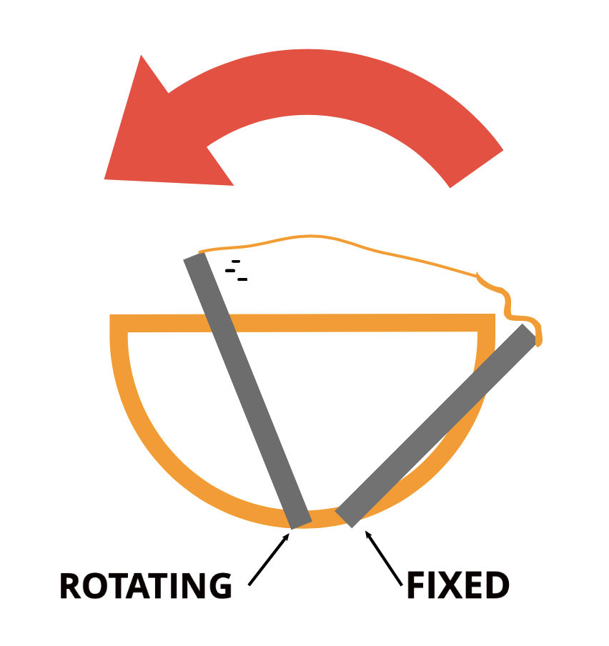
Basic project ideas with a clipart
This project is a self covering bowl to avoid unwanted messes that come from children knocking over their food bowls.

Slide 3

Target group
Our target audience is children between 1 ~ 5 years old.

Slide 4
Sensors and actuators and their functionality in the project
The design would consist of 4 tilt sensors parallel to the ground as well as 2 servos mounted to either side of the bowl. The sensors will each be angled 45 degrees off from the least so that tilt in any direction will be detected.
The servos would be parallel to each other connected to a lever.
These levers would be connected to an awning and the other side of the awning would be connected to two fixed rods.
When the tilt sensors detect the bowl is spilling, the servos will spring forward, pulling the awning over the top of the bowl, preventing food from falling out.

Slide 5
Status
We implemented the code for 4 tilt sensors with completed circuit wiring
We implemented a state of diagram for our codes
We have our tilt sensors and servos working in sync
We have a reset button to take the user from closed state to the open state

